Slide 1


AMERGED / COMPANY PRESENTATION
Agents Merged into your business
01 / COVER
Intelligence,
put to work.
AI agents, built around the way you work.
01
02
03
Custom software
Agentic systems
Training
Applications built around your data and workflows.
Context and tools that let agents do real work.
Your team learns to run and improve the system.
amerged.com
01 / 10
Notes:
Replace the headline, audience and summary. Keep the three-column lower grid and brand lockup.

Slide 2
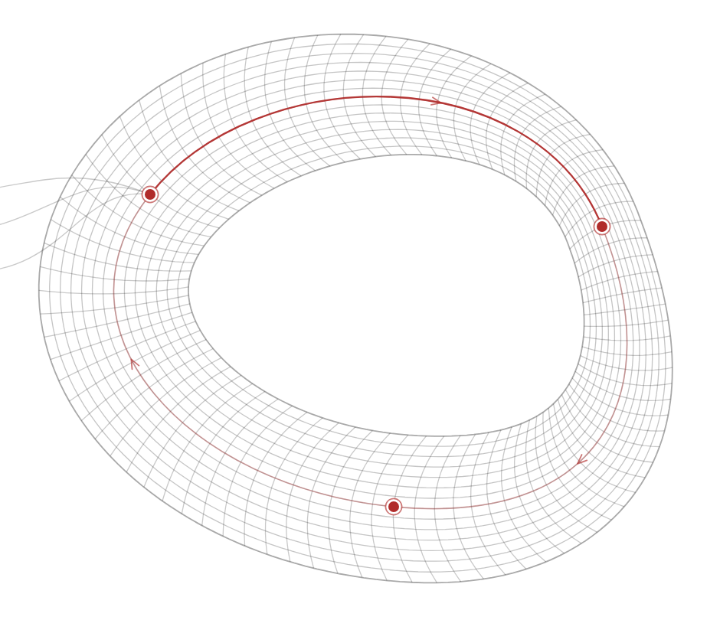
AMERGED / COMPANY PRESENTATION
Agents Merged into your business
02 / SECTION DIVIDER
01
AI adoption
Software, workflows and the people who run them.
amerged.com
02 / 10
Notes:
Use a short section title and one framing sentence. Keep the open whitespace.

Slide 3
AMERGED / COMPANY PRESENTATION
Agents Merged into your business
03 / COMPANY OVERVIEW
Agents merged into your business
One studio. Three connected disciplines.
01
02
03
Software
Systems
People
Applications and integrations built for your business.
AI agents connected to company knowledge and tools.
Hands-on training in AI engineering and organisational change.
OUR APPROACH
Understand the work. Build the system. Enable the people.
amerged.com
03 / 10
Notes:
Introduce the company with three specific areas of work. Use real capabilities and a concise positioning statement.

Slide 4
AMERGED / COMPANY PRESENTATION
Agents Merged into your business
04 / PROBLEM & OPPORTUNITY
The work behind the work
A clear view of the task before we build the system.
CURRENT PROCESS
DESIRED OUTCOME
Information is scattered
Useful work moves forward
People spend time finding context, moving data and repeating decisions.
Agents prepare the work in the tools your team already uses. People review the result.
STARTING POINT
A defined task, clear constraints and an outcome we can evaluate.
amerged.com
04 / 10
Notes:
Replace both columns with the audience’s actual current process and desired outcome. Avoid unsupported estimates.

Slide 5
AMERGED / COMPANY PRESENTATION
Agents Merged into your business
05 / TWO-COLUMN COMPARISON
Two ways to deliver the work
A balanced comparison with the same criteria on both sides.
MANUAL WORKFLOW
AGENT-ASSISTED WORKFLOW
Find context for each task
Use a shared company context
Move data between tools
Connect the tools in one workflow
Prepare every output by hand
Review the output before action
DECISION CRITERIA
Quality, effort and the level of oversight the task needs.
amerged.com
05 / 10
Notes:
Replace these examples with the real alternatives. Keep criteria parallel and retain limitations.

Slide 6
AMERGED / COMPANY PRESENTATION
Agents Merged into your business
06 / SERVICES
Three disciplines, one practice
Choose the work that makes a useful difference.
01
02
03
Custom AI software
Agentic transformation
Training & workshops
Applications, integrations and tools built around your data.
Process knowledge becomes context for systems that do the work.
Hands-on AI agents, AI engineering and organisational change.
SCOPE
A defined opportunity, a working system and a team that can use it.
amerged.com
06 / 10
Notes:
Use the three-column format for service lines or offers. Replace descriptions and scope with approved content.

Slide 7
AMERGED / COMPANY PRESENTATION
Agents Merged into your business
07 / PROCESS
The way we work
Understand the work. Then build the system.
01
02
03
Map
Engineer
Enable
Define the task, the constraints and what a useful outcome looks like.
Build the software. Connect the tools. Test it against real work.
Train the team to run, evaluate and improve the system.
FEEDBACK
What we learn becomes the next context.
amerged.com
07 / 10
Notes:
Use the three stages to explain delivery. Change stage titles and outputs together.

Slide 8
AMERGED / COMPANY PRESENTATION
Agents Merged into your business
08 / EVIDENCE & METRICS
Evidence from real work
A place for verified outcomes, with their baseline and source.
QUALITY
TIME SAVED
ADOPTION
[Result]
[Result]
[Result]
[Baseline, sample and measurement period]
[Baseline, sample and measurement period]
[Baseline, sample and measurement period]
SOURCE
[Source, owner and date. Replace with a verified reference.]
amerged.com
08 / 10
Notes:
Replace bracketed fields with approved metrics. Add the date, sample, measurement definition and source before presenting. These fields contain no performance claims.

Slide 9
AMERGED / COMPANY PRESENTATION
Agents Merged into your business
09 / ROADMAP
A roadmap for the work
A phased plan with a clear deliverable at each stage.
01
02
03
Discovery
Pilot
Rollout
[Timing]
Defined opportunity, constraints and success criteria.
[Timing]
A working system tested against the selected task.
[Timing]
A trained team, operating guidance and a review cadence.
NEXT MILESTONE
[Deliverable] [Owner] [Decision date]
amerged.com
09 / 10
Notes:
Replace phase durations with the agreed schedule. Keep owners and success criteria explicit.

Slide 10
AMERGED / COMPANY PRESENTATION
Agents Merged into your business
10 / CLOSING & CONTACT
Bring us
the problem.
Agents merged into your business.
xxxx
amerged.com
xxxx
xxxx
amerged.com
10 / 10
Notes:
Close with a specific discussion topic and the right contact details. Replace the contact person only with their approval.

